Slide 1
Operational Maximization of Space-Based Power Delivery to the Lunar Surface
Nate Uitenbroek
Sept 2023

Slide 2
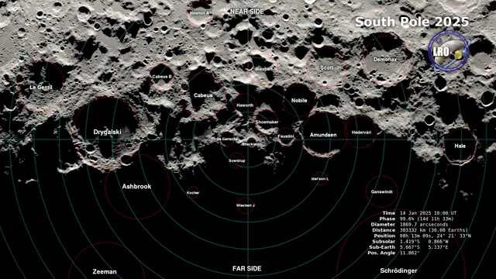
https://svs.gsfc.nasa.gov/cgi-bin/details.cgi?aid=5027&button=recent
Notes:
Lunar South Pole
Illumination conditions produce 14 days of light followed by 14 days of dark
Low sun angles produce PSR where volatile resources have been preserved
If we want to find them and exploit them we need a way to work in the dark

Slide 3
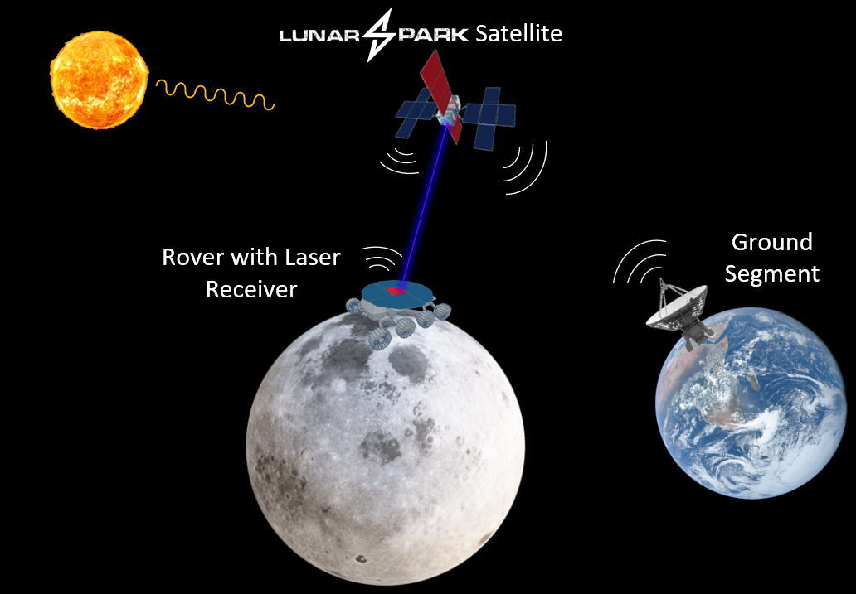
Notes:
CCP designed a space-based power delivery system

Slide 4
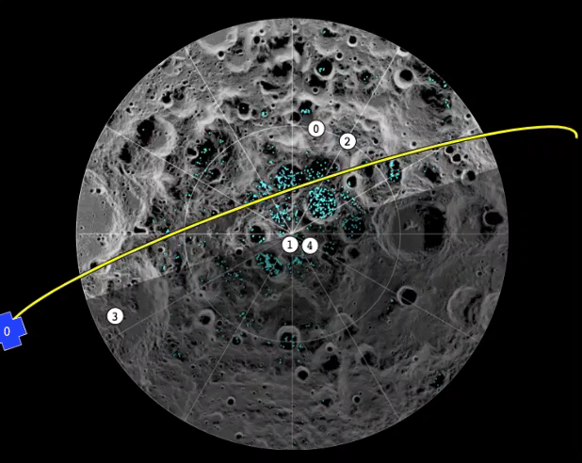
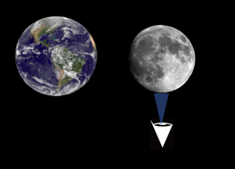
Operational Concept
Notes:
Looking at the south pole of the moon from 80 deg S lat to 90 deg S lat
Satellite is in a 90 inclined polar orbit
Each pass provides a delivery opportunity for one customer

Slide 5


Cyclic Operations Timeline for Power Delivery
Satellite 2
Satellite 1
Satellite 2
Satellite 1
Satellite 2
Orbit 0
Orbit 1
…Orbit n
Lunar Spark
Satellite 1
15 min
165 min
15 min
Lunar Spark
Satellite 2
165 min
15 min
165 min
15 min
Lunar Surface Vehicle
75 min
15 min
75 min
15 min
75 min
15 min
75 min
15 min
Laser Contact Time
Non-Contact Time

Slide 6

Cyclic Operations Timeline for Communication and Tasking
Satellite 1
Satellite 1
Satellite 1
Satellite 1
Satellite 1
Orbit 0
Orbit 1
…Orbit n
Lunar Spark
Satellite
15 min
75 min
15 min
75 min
15 min
75 min
15 min
75 min
15 min
Laser Contact Time (Power Delivery)
Gather Vehicle Status & Prepare for Earth Comm
Earth Communication & Vehicle Selection
Orbit Correction Maneuver
Vehicle Pointing, Search, & Acquisition

Slide 7
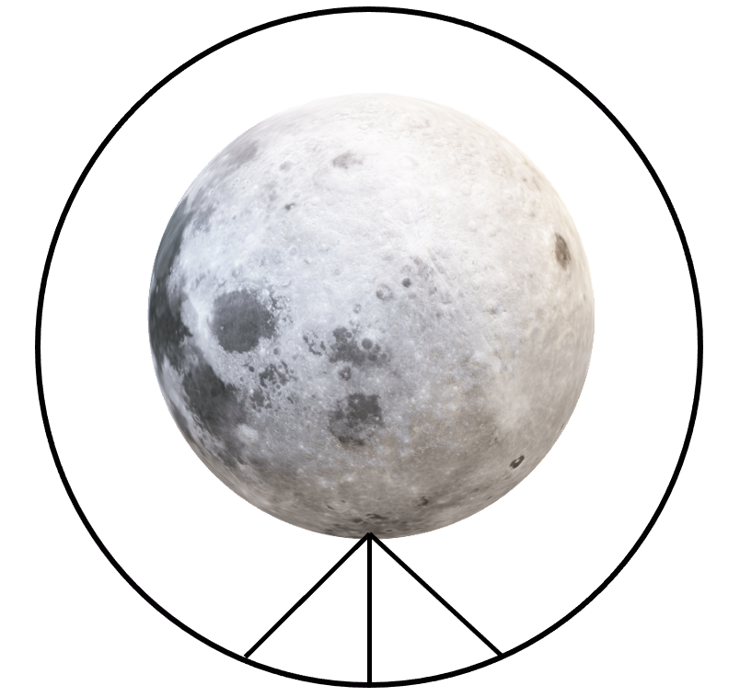
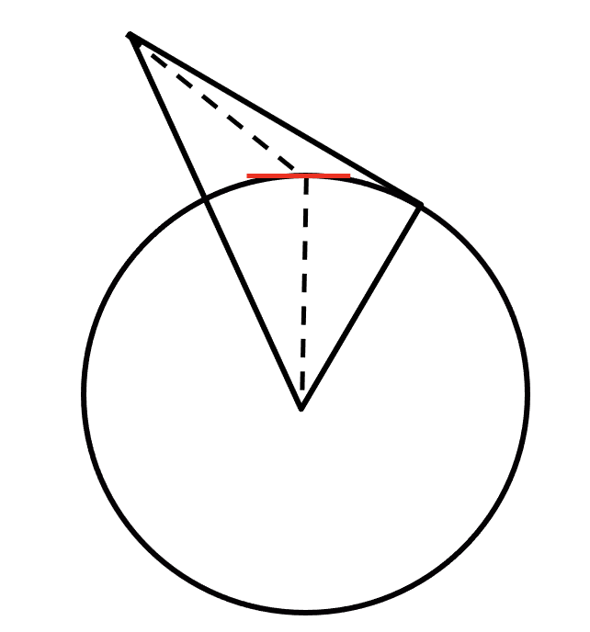
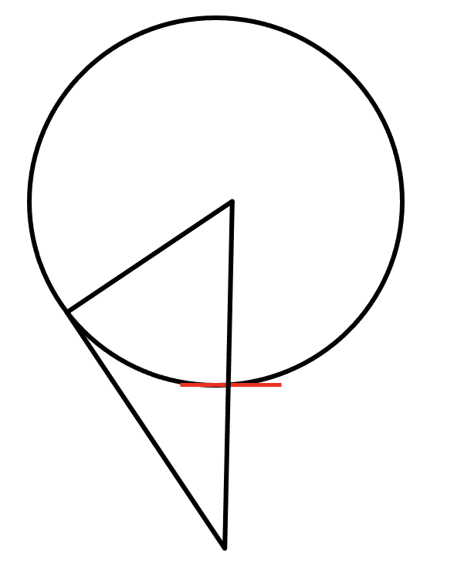
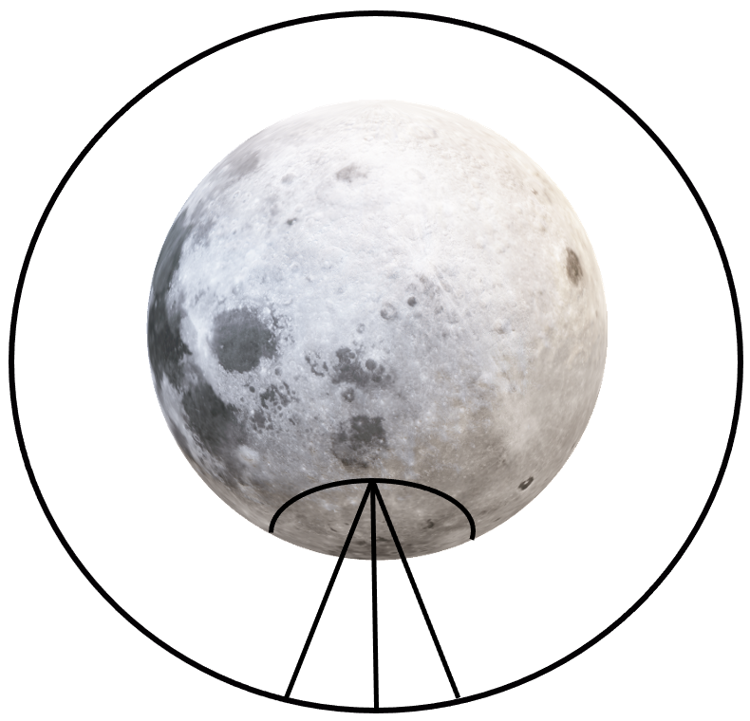
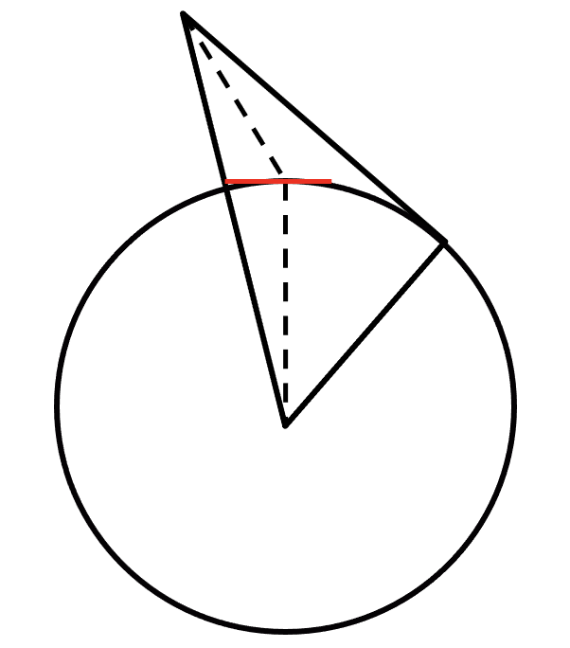
Direct Flyover Geometry
 | a | b | c
D (km) | 877 | 700 | 877
ε (deg) | 45 | 90 | 45
T (min) | 14.74
λ=14.7
λ=14.7
λ=0
ε = 45
ε = 45
ε = 90
a
c
a b c
b
Perpendicular Flyby 80° South Latitude Geometry
 | d | e | f
D (km) | 877 | 786 | 877
ε (deg) | 45 | 57.5 | 45
T (min) | 10.89
λ=14.7
λ=14.7
λ=10
ε = 45
ε = 45
ε = 57.5
d e f
f
d
e
Notes:
Different distances
Different angle
Per orbit

Slide 8
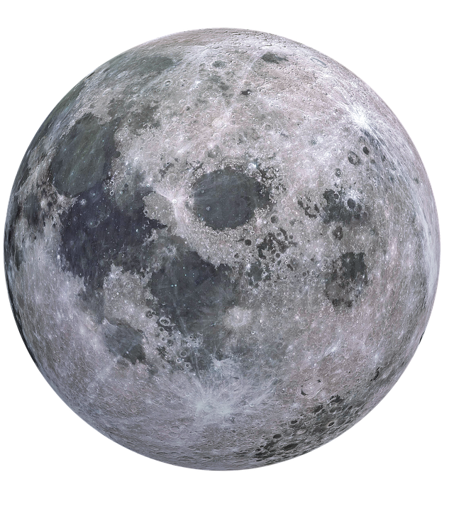
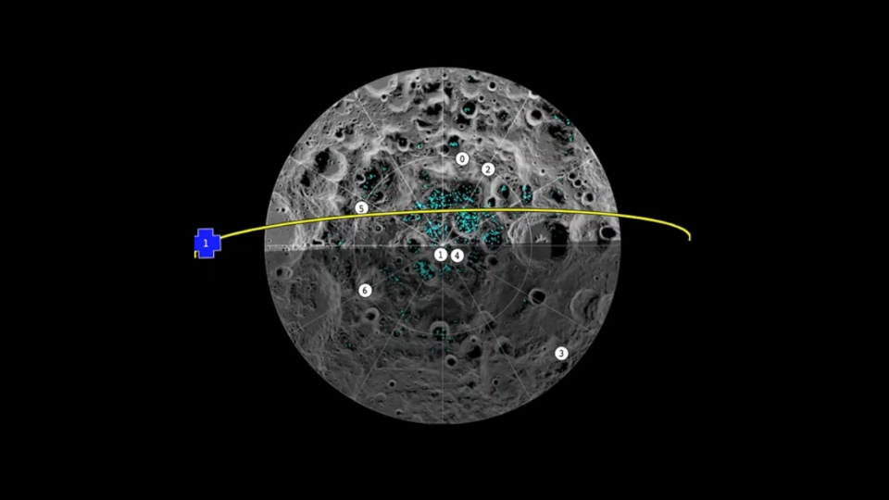

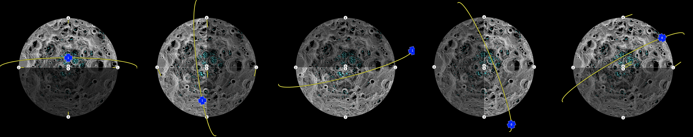
Sun Illumination and Satellite Orbit
TU
Graz
SpaceTech
Day 0.000
Day 7.375
Day 14. 750
Day 22.125
Day 29. 500
Notes:
Different orbits across the 29 day cycle
Range of geometries

Slide 9
Geometric Laser Pointing Losses
Best Case
Maximum Elevation (90°)
Worst Case
Minimum Elevation (45°)
beam r₁
beam r₁
receiver r₂
receiver r₂
r₁ = 81.1 cm r₂ = 37.5 cm
Efficiency = 21.4%
r₁ = 97.8 cm r₂ = 37.5 cm
Efficiency = 10.4%
Notes:
Beam characteristics
Every vehicle location and every orbit starts with the worst case and ends with the worst case

Slide 10
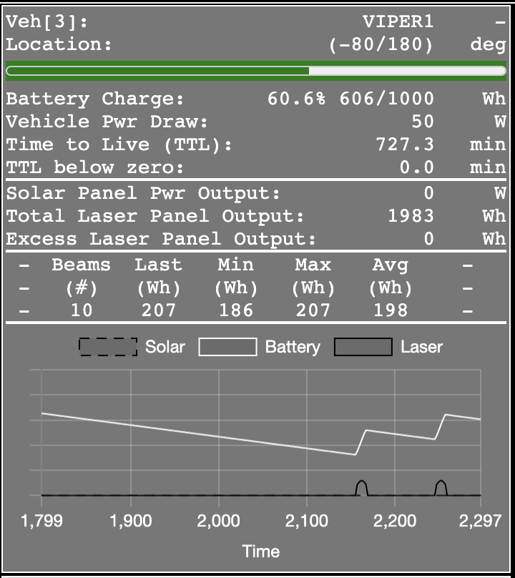
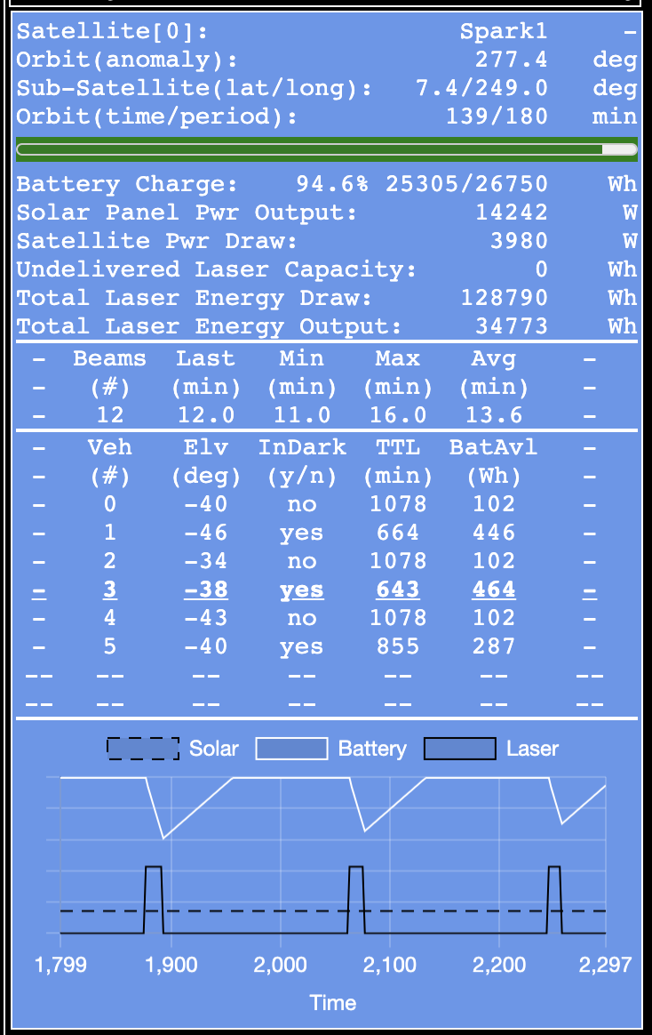
Vehicle and Satellite Models
Name & Location
Power
Status
Beam Statistics
Vehicle View & Target Selection
Historical Strip Chart
Notes:
Name and locations
Surface latitude and longitude with illumination indicated by black for darkness orange for light
Satellite location is modeled for both orbit anamoly and sub-satellite point
Power systems consist of solar panels and batteries with the laser receiver on the vehicle and laser power on the satellite also being modeled.
Vehicle locations, battery sizes and power draws are configurable via files for each of the scenarios I tested.
Beam modeling keeps track of how many beams were transmitted and received along with the energy delivered and laser on times.
This includes the last beam, minimum, maximum, and average
Vehicle strip chart
Satellite strip chart
Satellite also has a view of the vehicle data that is gathered during the departure from the sout pole and an indication of which vehicle is selected for the next delivery window

Slide 11
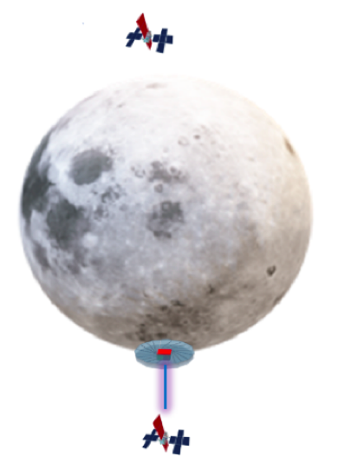
System Constraints
One vehicle selected per satellite pass
No satellite-to-satellite communication
Vehicles in sunlight will not request power
Frozen vehicles will not request power
Notes:
Only one surface vehicle can be targeted per satellite pass over the south polar region
Target vehicle selection must only use information gathered during the last pass over the south polar region (no satellite-to-satellite communication)
Vehicles in sunlight will not request power from the space-based power delivery system
Frozen vehicles will not request power from the space-based power delivery system

Slide 12
Power Delivery Measures of Effectiveness
Laser Power Draw
Delivered Energy Efficiency | 2.45% - 2.74% (driven by vehicle location)
Excess Delivery | Zero is optimal
Usable Energy Efficiency | Equal to Delivered Efficiency is optimal
Undelivered Capacity | Zero is optimal Undelivered Capacity is preferred to Excess Delivery
Frozen Vehicles | Zero is optimal
Electrical to
Optical Loss
Laser Output
Geometric
Beam Loss
Laser Receiver Output
Excess
Delivery
Vehicle Power System
Notes:
Delivered Energy Efficiency is measured from the laser input to the laser receiver output
Excess delivery is delivered energy that can’t be stored (waste)
Particularly interesting when considering multiple vehicle scenarios
Usable Energy Efficiency measures all the way to the vehicle power system (zero excess is best)
Avoiding Excess delivery can lead to Undelivered Capacity. Ideally this would be zero, but it really depends on the vehicle scenario putting enough demand on the system
Too much demand leads to power outages and frozen vehicles. Obviously we want all the vehicles in our scenario to survive
Laser Panel Output /
Laser Power Draw
Energy from Laser Panel Output that cannot be stored
Storable Energy /
Laser Power Draw
Accumulation of Laser Panel Output Power that could have been delivered
Count of vehicles that lost all power for some amount of time and therefore froze

Slide 13
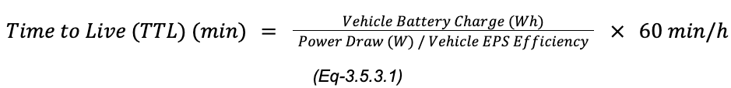
Power Delivery Algorithm – Step 1
Prioritize Vehicles by Time to Live (TTL)
Lowest TTL is the highest priority
Notes:
Vehicles have different size batteries and diverse power draw profiles.
We need a way to compare a set of vehicle and come up with who is the ‘neediest’
For that we calculate each vehicles time to live
Equation
Lowest TTL becomes the highest priority

Slide 14
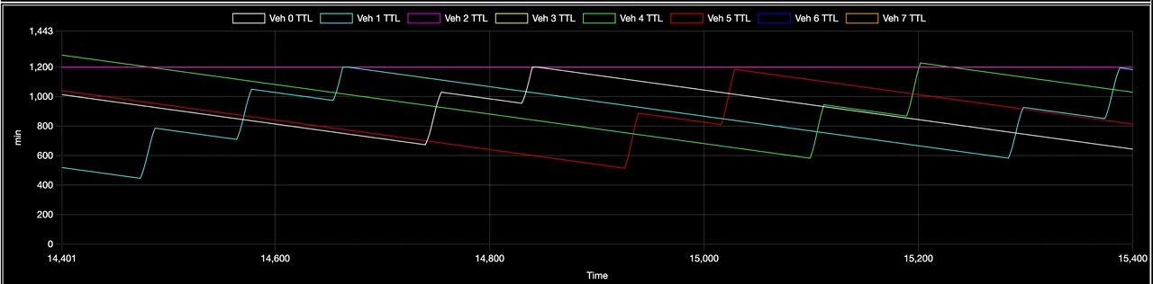
Time to Live (TTL)
Notes:
This is a TTL strip chart showing the time history of the TTL for several vehicles
When a vehicle becomes the lowest TTL it is selected for delivery
You can see how the time lag between decision and delivery produces an additional delivery that occurs past the point where a vehicle is the lowest TTL
This is because in between the selection of a vehicle as the lowest TTL and delivery the other satellite has delivered a beam
This artifact of the decision timeline nearly always produces a double delivery (one satellite then the other) and a priority inversion for the second delivery
Adding third satellite or communication network could allow for more timely state data to be gathered and sharing of what the other satellite is planning.
For now, I’ve chosen to live with this priority inversion.

Slide 15
Power Delivery Algorithm – Step 2
Before a vehicle is selected it must meet ALL the selection criteria
If the highest priority vehicle does not meet the criteria the next one is tested
If no vehicle is selected the system accumulates undelivered capacity
Selection Criteria
Vehicle must be in the dark
Vehicle must have adequate capacity to receive the full power delivery
Vehicles with small battery capacity are exempt from this criteria
Vehicle must have a chance to live until a satellite returns
Notes:
Next thing I needed to do was identify scenarios that where TTL alone was producing sub-optimal results with respect to the MOEs and constraints of the system.
For this I came up with a set of selection criteria that must be met before a vehicle is chosen for power delivery.
Vehicles in the light don’t need laser power. Vehicles in the dark should always be prioritized
Next we want to avoid Excess Delivery. Energy that can’t be stored is wasted.
However, if your battery is so small you can’t even store an entire beam I have no choice but to deliver
Lastly, you have to have a chance to survive for me or my partner satellite to get there
If you’re going to be frozen before I get there, then I can’t delivery to you anyway
Vehicle must be in the dark
Vehicle must have adequate capacity (> 325 Wh) to receive the full power delivery
Vehicles with small battery capacity (< 450 Wh) are exempt from this criteria
Vehicle must have a chance to live until the satellite returns (TTL > 75 min)
Threshold values above required tuning experiments

Slide 16
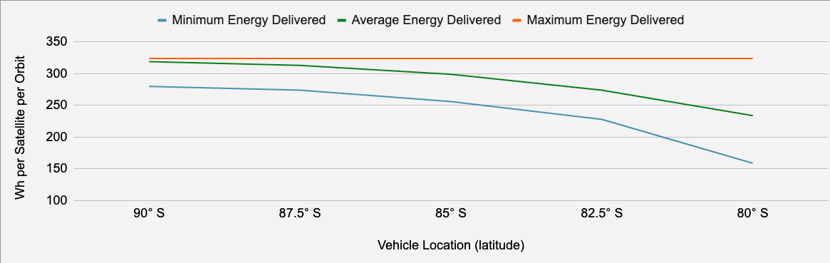
Adequate Capacity Threshold
Adequate Capacity Threshold = 325 Wh
Notes:
Ran several experiments at different latitudes
Maximum beam energy for all of them was 324 Wh
This is because there is always a direct flyover at some point during the simulation
Set threshold to 325 Wh

Slide 17
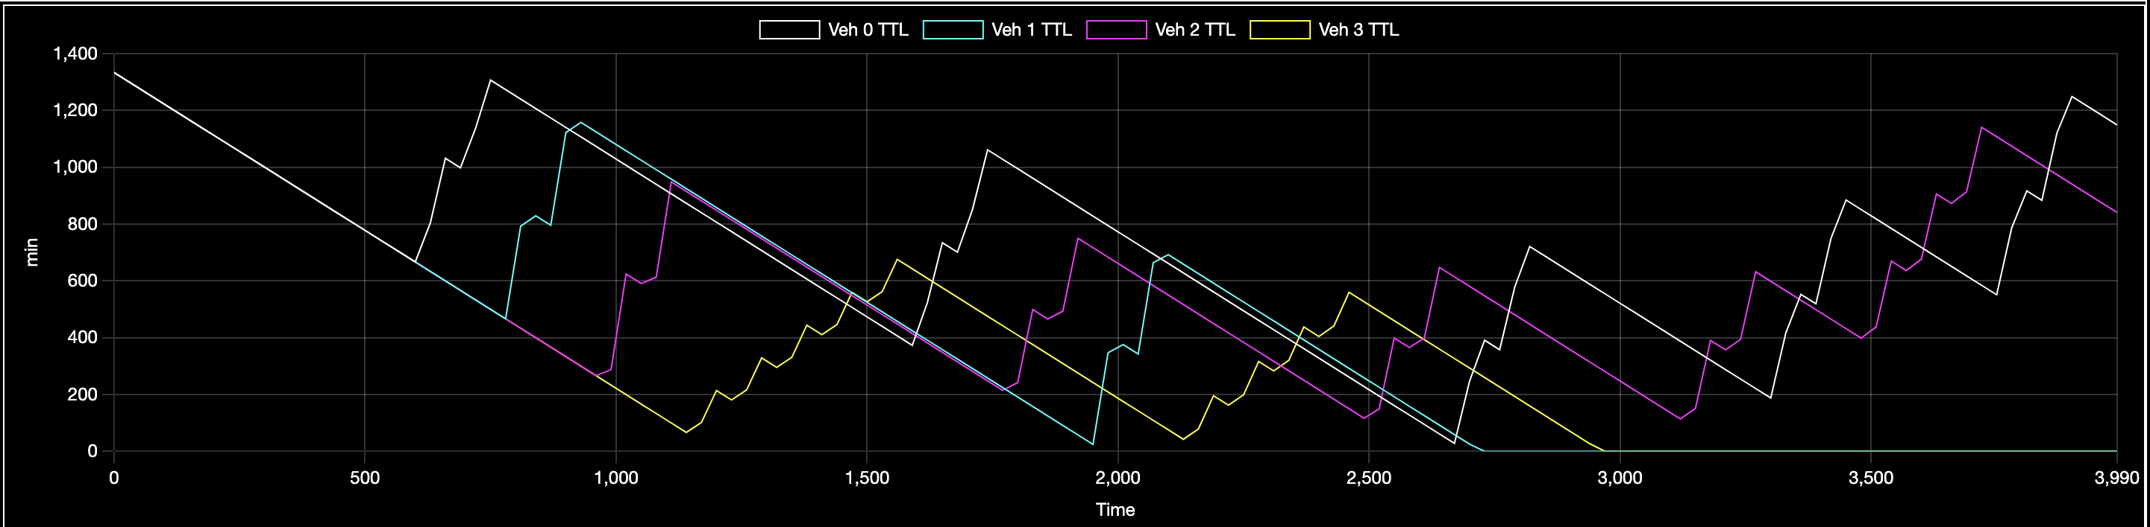
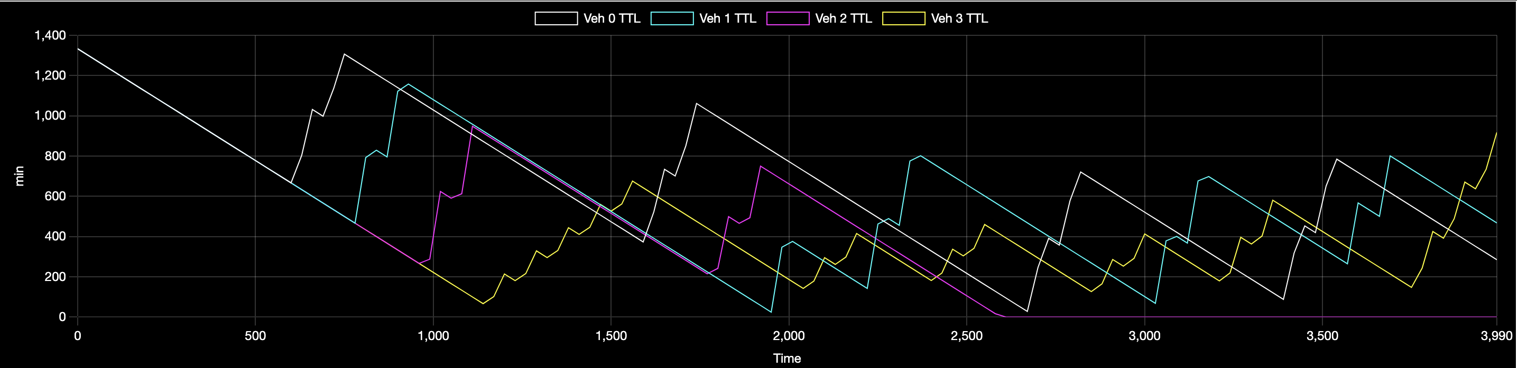
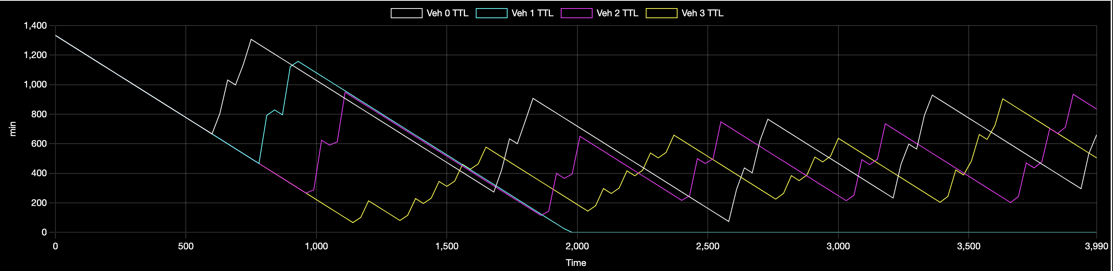
Chance to Live
TTL > 0 min = chance to live
Gave up at 2760 min
Frozen Vehicles: 2
TTL > 75 min = chance to live
Gave up at 1800 min
Frozen Vehicles: 1
TTL > 120 min = chance to live
Gave up at 1080 min
Frozen Vehicles: 1
Notes:
Four vehicles configured with more power draw than the system could provide.
System could support 3 but not 4
Chance to live threshold set to zero lost 2 vehicles
Chance to live set to 75 min or 120 min only lost on vehicle
I put this into the automated algorithm but ideally this would be an operator decision before you get this point

Slide 18
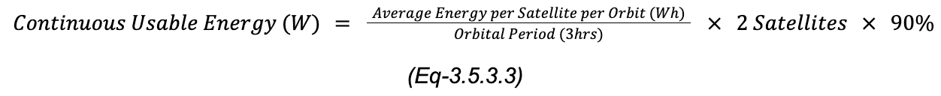
Continuous Usable Energy
Given the average energy delivery per satellite per orbit, the continuous usable energy can be calculated for a given vehicle latitude
Vehicle Location (latitude) | 90° S | 87.5° S | 85° S | 82.5° S | 80° S
Average Energy Delivered / Sat / Orbit (Wh) | 319 | 313 | 299 | 274 | 238
Continuous Usable Energy Two Satellite System (W) | 191 | 188 | 179 | 164 | 143
Continuous Usable Energy per Satellite (W) | 95.5 | 94 | 89.5 | 82 | 71.5
Notes:
Characterize the system in terms of Continuous Usable Energy
Take the average at any given latitude we can [do the equation]
Of the system
Of the each satellite
At the south pole the system can deliver 191W
At VIPER mission location (85 deg) we can deliver 89.5W per satellite (fully redundant)
At the edge of our service area we can only achieve 71.5W with a single satellite

Slide 19
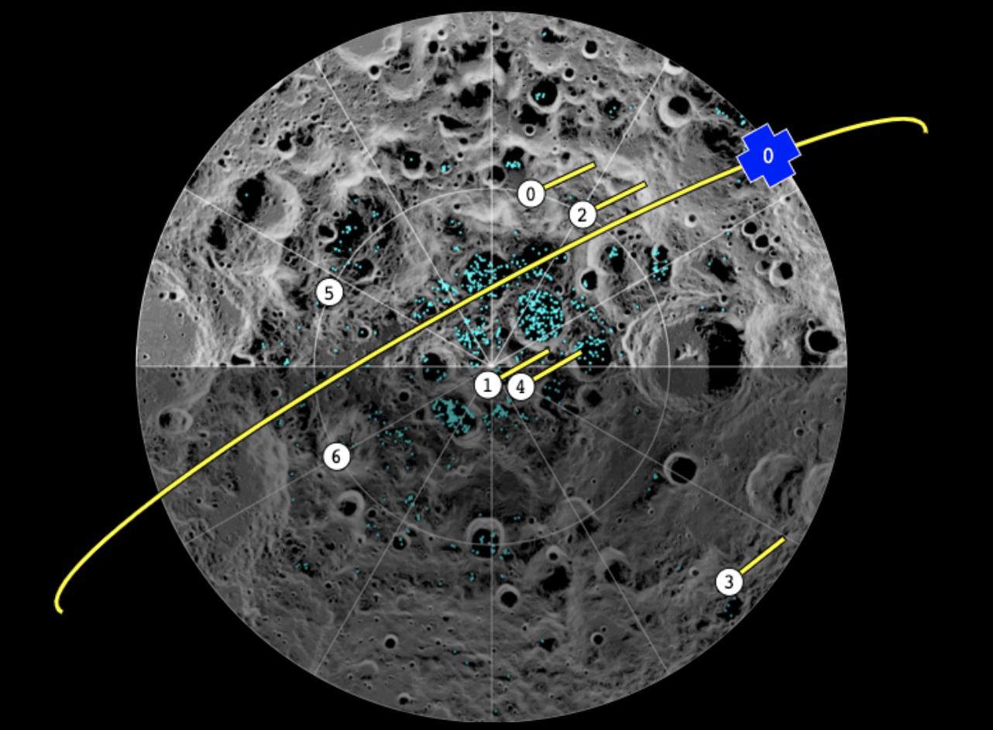
Planned Lunar Missions
# | Vehicle | Survival Power Draw (W) | Battery (Wh)
0 | IM Nova-C (Mosher & Tillotson, 2018) (Intuitive Machines, 2022, 12, 30) | 50 | 1625
1 | IM Nova-C (Smith, 2021) (Intuitive Machines, 2022, 12, 30) | 50 | 1625
2 | VIPER (NASA VIPER, 2022) (Bartels, 2019) (Shirley, 2021) | 80 | 5625
3 | Draper Series 2 (Mosher & Tillotson, 2018) (Handal, 2022) | 25 | 1188
4 | Chang'E 7 (Chacko, 2023) (Yong & Ruihong, 2023) | 12.5 | 250
5 | Outland MAPP (Intuitive Machines, 2022, 13) | 25 | 500
6 | Astrobotic Peregrine (Astrobotic, 2021, 11) | 25 | 1250
Small Battery Threshold = 450 Wh

Slide 20
Lunar Spark Simulation Demo
Lunar Spark simulation is hosted on GitHub
https://uitenbro.github.io/lunarspark/
Source Code
https://github.com/uitenbro/lunarspark

Slide 21
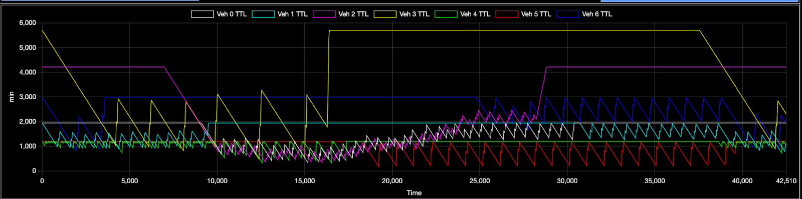
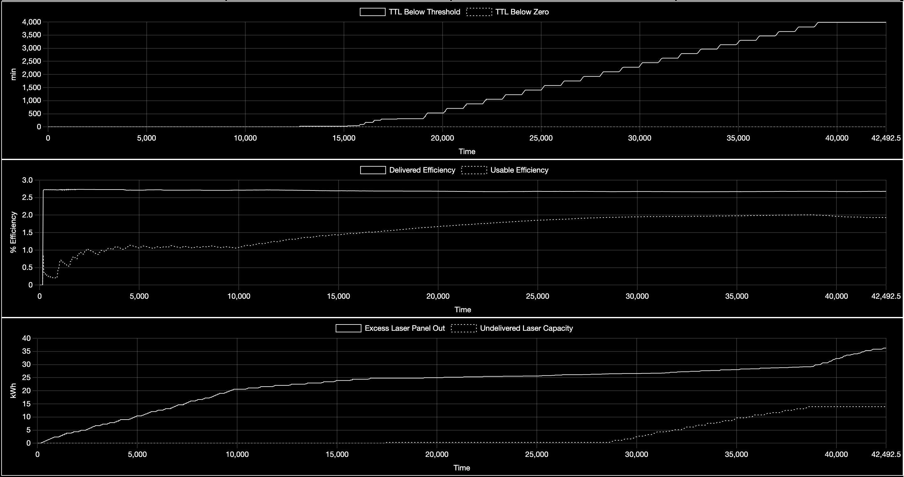
Planned Missions Scenario Measures of Effectiveness

Slide 22
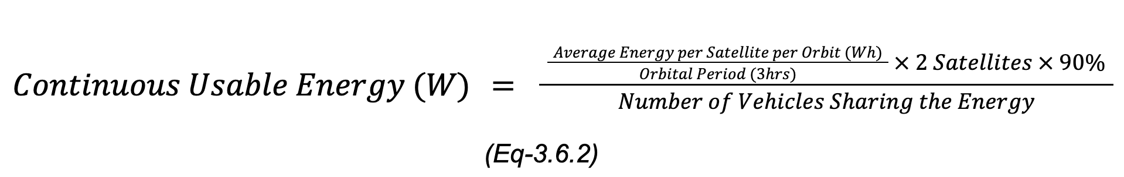
Continuous Usable Energy with Sharing
The continuous usable energy produced by the system needs to be shared by all vehicles who are in the darkness together

Slide 23
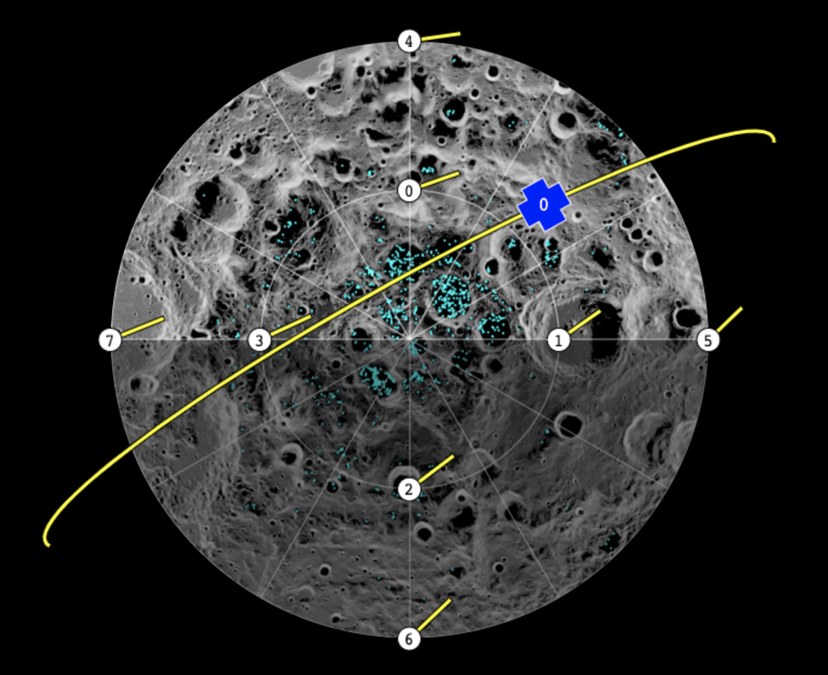
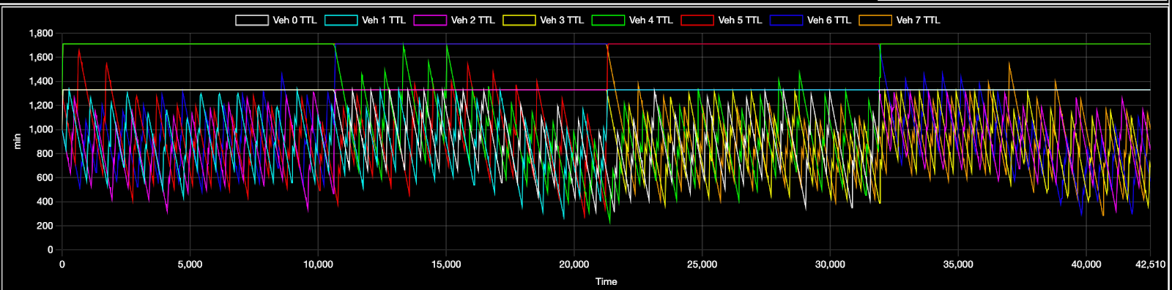
Spread Out Scenario
Vehicle # (color) | Power Draw (W) | Time TTL below 2 orbits (min) | TTL min (min) | TTL max (min)
0 (white) | 45 | 126 | 303 | 1330
1 (aqua) | 45 | 156 | 264 | 1330
2 (violet) | 45 | 159 | 288 | 1330
3 (yellow) | 45 | 24 | 335 | 1330
4 (green) | 35 | 186 | 223 | 1711
5 (red) | 35 | 114 | 271 | 1711
6 (blue) | 35 | 192 | 263 | 1711
7 (orange) | 35 | 169 | 287 | 1711

Slide 24
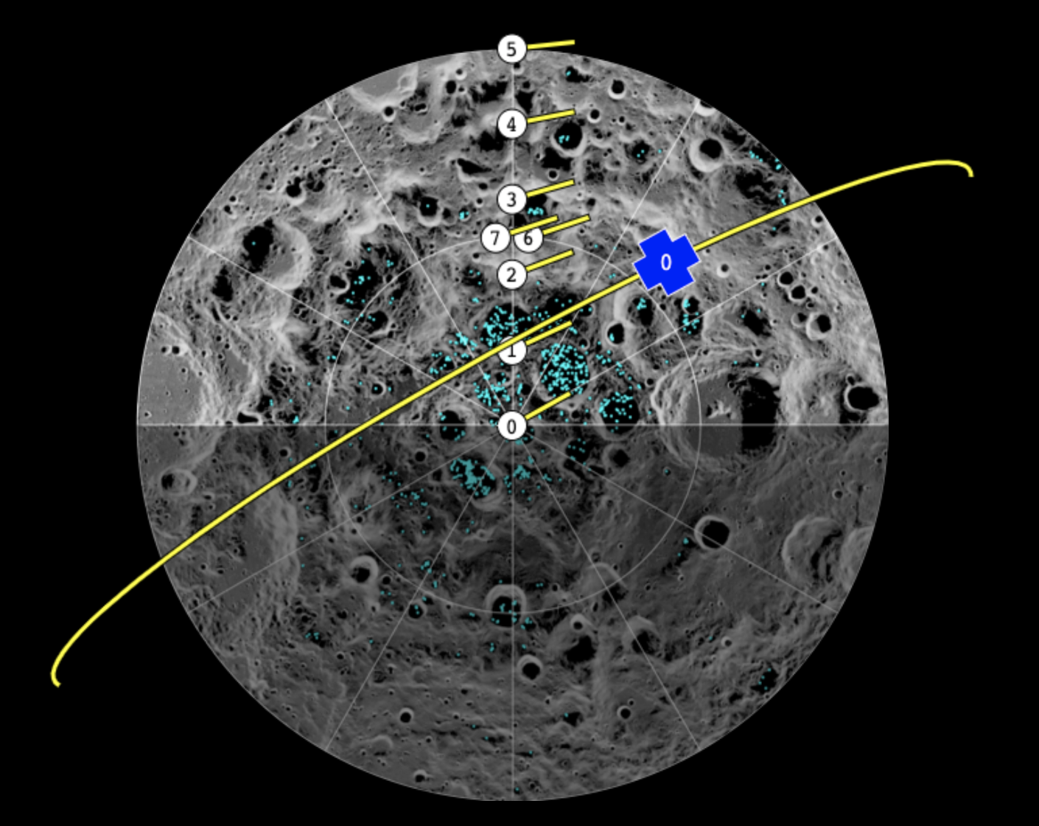
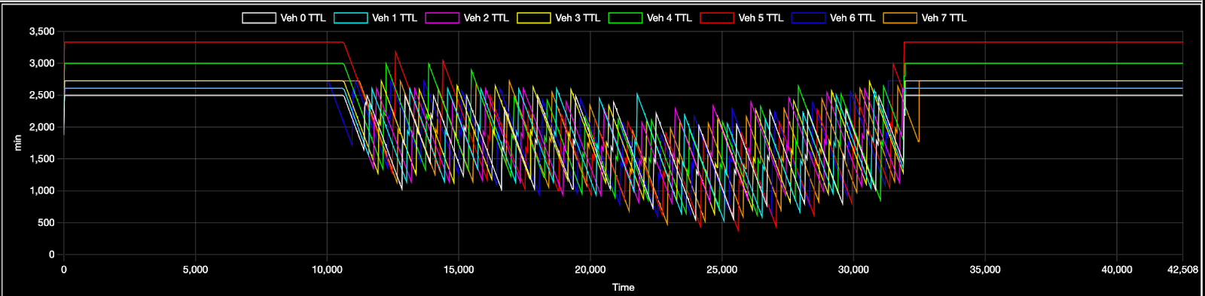
Maximum Sharing Scenario
Vehicle # (color) | Power Draw (W) | Time TTL below 2 orbits (min) | TTL min (min) | TTL max (min)
0 (white) | 24 | 0 | 539 | 2497
1 (aqua) | 23 | 0 | 513 | 2605
2 (violet) | 23 | 0 | 795 | 2605
3 (yellow) | 22 | 0 | 625 | 2724
4 (green) | 20 | 0 | 607 | 2997
5 (red) | 18 | 0 | 363 | 3330
6 (blue) | 22 | 0 | 576 | 2724
7 (orange) | 22 | 0 | 469 | 2724

Slide 25
Summary and conclusion
Lunar exploration happens in the dark and space-based power delivery is the solution
Power delivery will use Time to Live (TTL) to set the priority and selection criteria to determine the target vehicle
Testing shows that multiple mission scenarios could be serviced with the designed system

Slide 26
References
Astrobotic. (2021). ASTROBOTIC LUNAR LANDERS Payload User’s Guide (5.0 ed.). Astrobotic Technology. https://www.astrobotic.com/wp-content/uploads/2022/01/PUGLanders_011222.pdf
Bartels, M. (2019, October 25). NASA Will Launch a Lunar VIPER to Hunt Moon Water in 2022. Space.com. Retrieved August 8, 2023, from https://www.space.com/nasa-viper-moon-rover-launching-in-2022.html
Chacko, A. J. (2023, August 5). China's ambitious blueprint: Chang'e-7 seeks lunar water. Interesting Engineering. Retrieved August 8, 2023, from https://interestingengineering.com/science/chinas-ambitious-blueprint-change-7-seeks-lunar-water
ESA Heracles. (2023). Landing on the Moon and returning home: Heracles. European Space Agency. Retrieved August 12, 2023, from https://www.esa.int/Science_Exploration/Human_and_Robotic_Exploration/Exploration/Landing_on_the_Moon_and_returning_home_Heracles
Handal, J. (2022, July 21). NASA Selects Draper to Fly Research to Far Side of Moon. NASA. Retrieved August 9, 2023, from https://www.nasa.gov/press-release/nasa-selects-draper-to-fly-research-to-far-side-of-moon
Intuitive Machines. (2022). Lunar Access Services User's Guide (1.4 ed.). Intuitive Machines. https://www.intuitivemachines.com/_files/ugd/7c27f7_458cf85ba6e94ba18f33702dc2c326af.pdf
Larson, W. J. (2015). Space Mission Analysis and Design Core (3rd ed.). CEI Publications.
Mosher, J., & Tillotson, M. (2018, April 16). Schrödinger-Zeeman Basin. The Moon Wiki. Retrieved August 9, 2023, from http://the-moon.us/wiki/Schr%C3%B6dinger-Zeeman_Basin
Mosher, M., & Tillotson, J. (2018, April 16). Malapert. The Moon Wiki. Retrieved August 8, 2023, from https://the-moon.us/wiki/Malapert
NASA CLPS. (2023, May 24). Commercial Lunar Payload Services Overview. NASA CLPS. Retrieved August 8, 2023, from https://www.nasa.gov/commercial-lunar-payload-services-overview
NASA VIPER. (2022, October 28). Volatiles Investigating Polar Exploration Rover (TO 20A, VIPER). NASA - NSSDCA. Retrieved August 8, 2023, from https://nssdc.gsfc.nasa.gov/nmc/spacecraft/display.action?id=VIPER
Saleh, B. E. A., & Teich, M. C. (2007). Fundamentals of Photonics. Wiley.
Shirley, M. (2021, September 20). We're NASA experts on the VIPER mission. Ask us anything about the water-seeking Moon rover or its landing site on the Moon! : r/space. Reddit. Retrieved August 9, 2023, from https://www.reddit.com/r/space/comments/ps4zmz/were_nasa_experts_on_the_viper_mission_ask_us/
Smith, H. (2021, November 3). NASA, Intuitive Machines Announce Landing Site for Lunar Drill. NASA. Retrieved August 8, 2023, from https://www.nasa.gov/feature/nasa-intuitive-machines-announce-landing-site-location-for-lunar-drill
SpaceTech. (2023). Lunar Spark - Space-Based Energy Delivery for the Lunar Surface. TU Graz Central Case Project (CCP).
Szyk, B. (2023, June 5). Azimuth Calculator. Omni Calculator. Retrieved August 10, 2023, from https://www.omnicalculator.com/other/azimuth
Ugucinni, N. R., & Tian, L. (2022, January 17). Power Hibernation: Surviving the Extreme Cold Lunar Environment. Lunar Surface Innovation Consortium. Retrieved August 26, 2023, from https://lsic.jhuapl.edu/uploadedDocs/focus-files/1120-EE%20Monthly%20Meeting%20-%202022%2001%20January_Presentation%20-%20NASA%20Glenn.pdf
Williams, D. R. (2021, December 20). Moon Fact Sheet. NSSDCA. Retrieved August 9, 2023, from https://nssdc.gsfc.nasa.gov/planetary/factsheet/moonfact.html
Yong, G., & Ruihong, Y. (2023, February 1). Announcement of Opportunity Solicitating for Payloads onboard Chang’E-7 Mission. China National Space Administration. Retrieved August 9, 2023, from http://www.cnsa.gov.cn/english/n6465652/n6465653/c6840870/part/6797907.pdf

Slide 27
Back Up

Slide 28
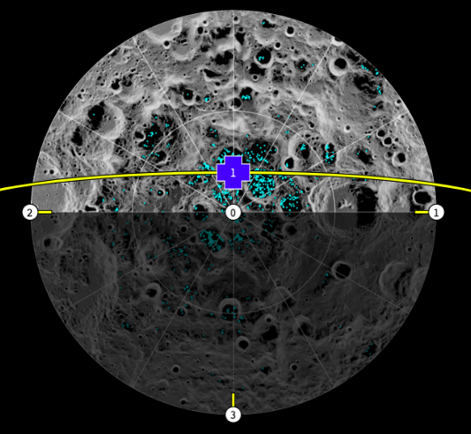
Cyclic Operations Timeline for Power Delivery
Contact time is affected by vehicle location relative to the orbit ascending node
Direct flyover results in 14.7 min of contact time over 45 degrees elevation
Perpendicular locations at 80 degrees south latitude result in 10.9 min of contact time

Slide 29
Model System Characteristics
Laser Wavelength
445 nm
Laser Initial Diameter
30 cm
Orbit
700 km
Laser Power Output
12.8 kW
Power Delivery Elevation Angle
45 degrees
Receiver Diameter
75 cm
Customer Power Draw
80 W ???

Slide 30
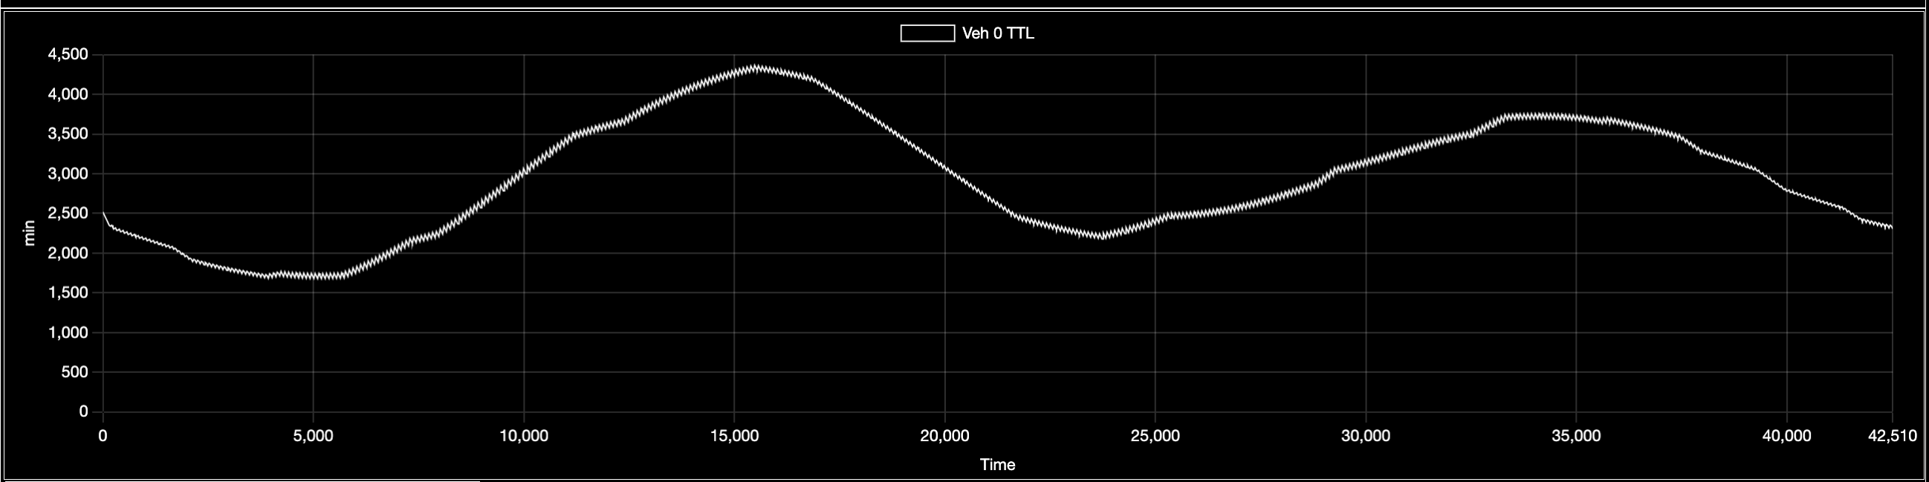
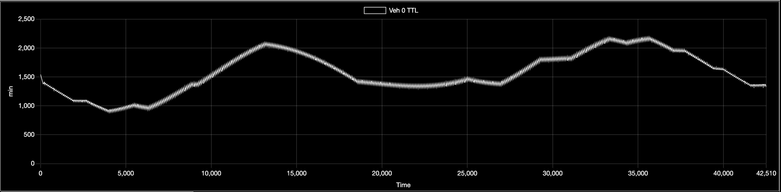
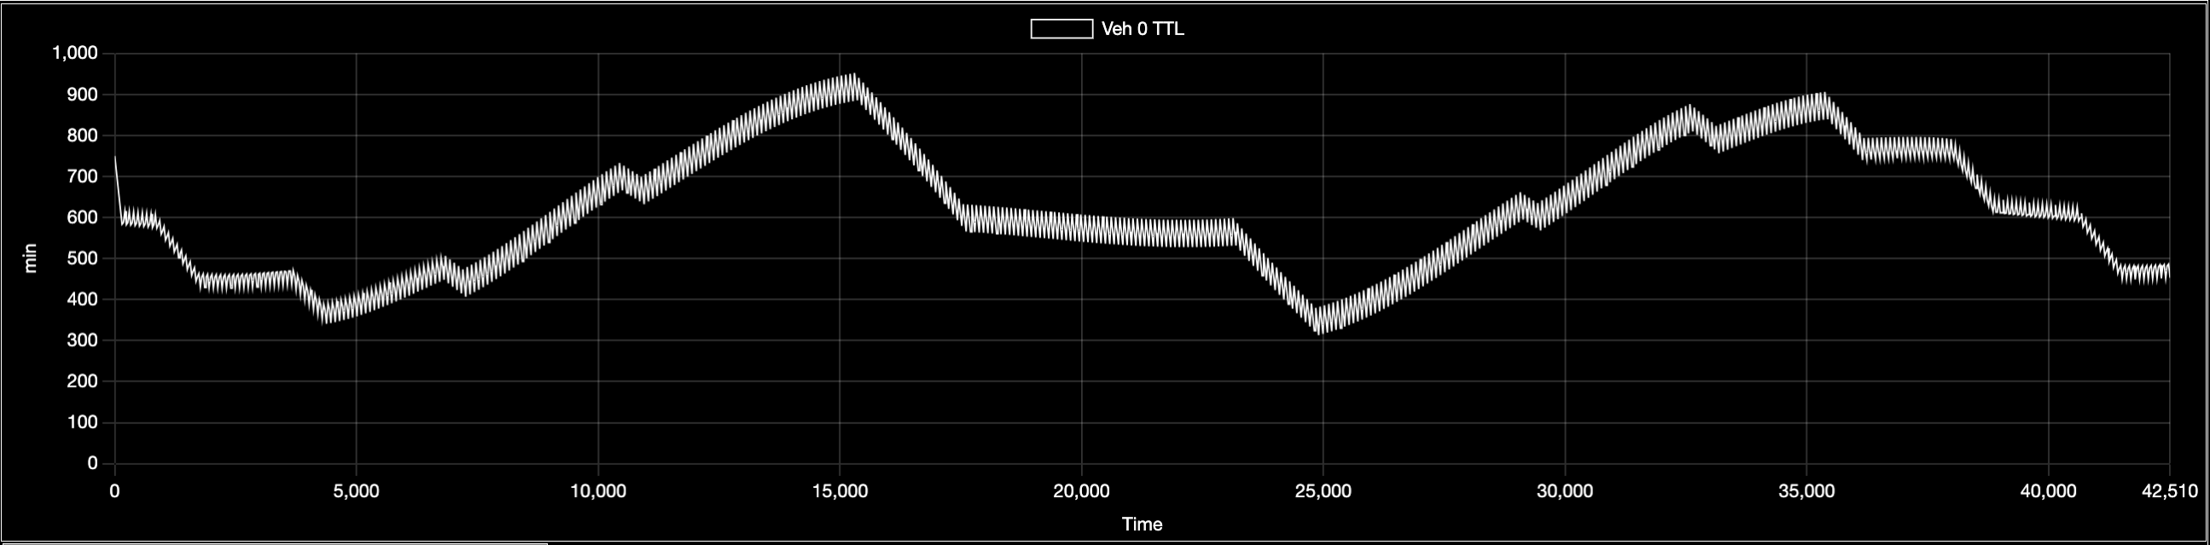
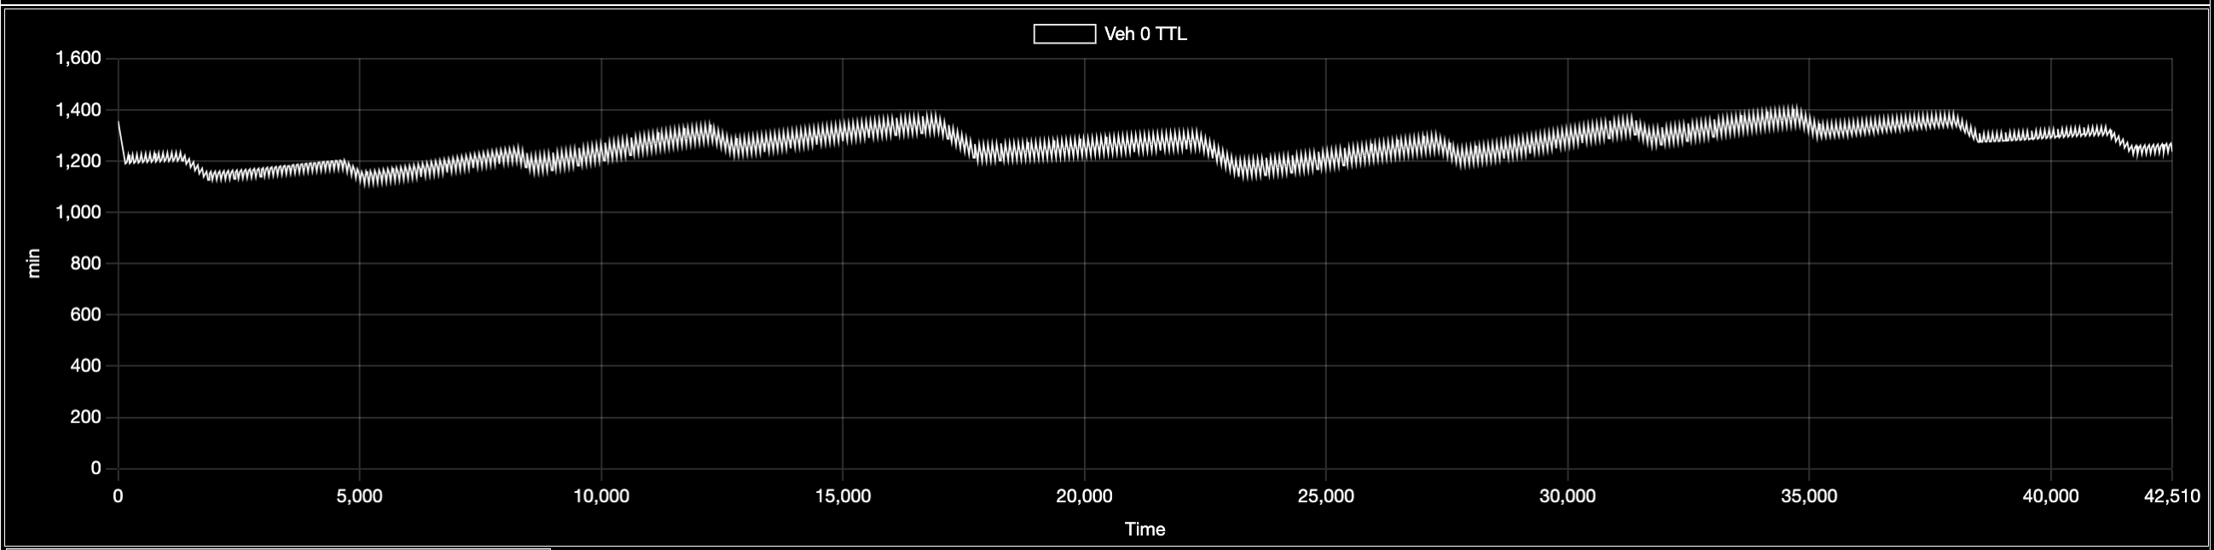
Continuous Usable Energy - Variability
Vehicle Latitude: 80° S
Continuous Power: 143 W
TTL Variability: +/- 1500 min
Vehicle Latitude: 82.5° S
Continuous Power: 165 W
TTL Variability: +/- 700 min
Vehicle Latitude: 85° S
Continuous Power: 180 W
TTL Variability: +/- 350 min
Vehicle Latitude: 87.5° S
Continuous Power: 188 W
TTL Variability: +/- 150 min

Slide 31
Operational Simulation Environment Model
Lunar Surface Vehicle Model
Space-Based Power Delivery Satellite Model
Solar Array
Solar Array Power
Solar Array
Sun Illumination Model
Laser Panel Receiver
Solar Array Power
Sun Angle
Receiver Output Power
EPS and Battery
EPS and Battery
Vehicle Location Model
Battery Charge
Battery Charge
In Night / In Shadow
Vehicle (Lat, Long)
Laser
Beam Characteristics Model
Laser Power Draw
Elevation
Beam Divergence
Satellite Orbit Model
Beam Intensity (Range)
Orbit Anomaly
Power Delivery Algorithm
Satellite (Lat, Long)
Laser On

Slide 32
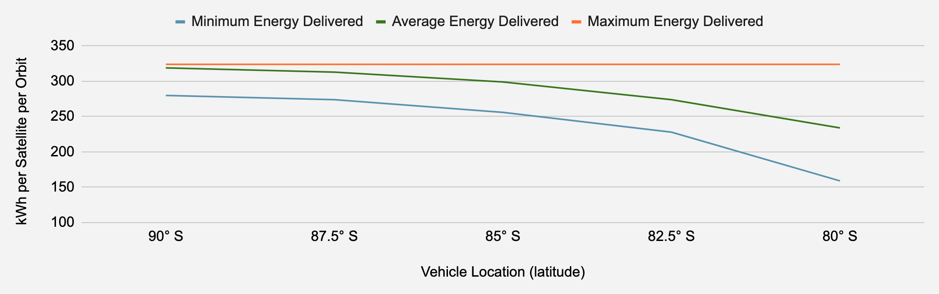
Delivered Energy and Adequate Capacity
Vehicle Location (latitude) | 90° S | 87.5° S | 85° S | 82.5° S | 80° S
Delivered Energy Efficiency | 2.74% | 2.72% | 2.65% | 2.55% | 2.45%
Minimum Energy Delivered / Sat / Orbit (kWh) | 280 | 274 | 256 | 228 | 159
Average Energy Delivered / Sat / Orbit (kWh) | 319 | 313 | 299 | 274 | 238
Maximum Energy Delivered / Sat / Orbit (kWh) | 324 | 324 | 324 | 324 | 324

Slide 33
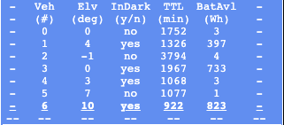
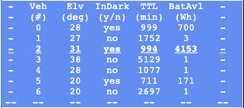
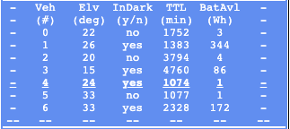
Target Selection
TTL Priority
Adequate Capacity
Small Battery

Slide 34
Planned Lunar Missions
# | Location (latitude, longitude) | Vehicle | Nominal Power Draw (W) | Survival Power Draw (W) | Battery (Wh)
0 | Malapert A Crater (85S 13E) | IM Nova-C (Mosher & Tillotson, 2018) (Intuitive Machines, 2022, 12, 30) | 200 | 50 | 1625
1 | Lunar South Pole (89.5S, 10W) | IM Nova-C (Smith, 2021) (Intuitive Machines, 2022, 12, 30) | 200 | 50 | 1625
2 | Nobile Crater (85S, 31E) | VIPER (NASA VIPER, 2022) (Bartels, 2019) (Shirley, 2021) | 320 | 80 | 5625
3 | Schrödinger Basin (81S, 132E) | Draper Series 2 (Mosher & Tillotson, 2018) (Handal, 2022) | 100 | 25 | 1188
4 | Shackleton Crater (89S, 123E) | Chang'E 7 (Chacko, 2023) (Yong & Ruihong, 2023) | 50 | 12.5 | 250
5 | (85S, 120W) | Outland MAPP (Intuitive Machines, 2022, 13) | 100 | 25 | 500
6 | (85, 120E) | Astrobotic Peregrine (Astrobotic, 2021, 11) | 100 | 25 | 1250
7 | (90S, 0E) | Astrobotic Griffin (Astrobotic, 2021, 22) | 600 | 150 | 6250

Slide 35
Planned Mission Scenario
Vehicle # (color) | Power Draw (W) | Time TTL below 2 orbits (min) | TTL min (min) | TTL max (min)
0 (white) | 50 | 126 | 294 | 1755
1 (aqua) | 50 | 0 | 690 | 1755
2 (violet) | 80 | 192 | 285 | 3797
3 (yellow) | 13 | 0 | 412 | 5132
4 (green) | 13 | 162 | 282 | 1080
5 (red) | 25 | 3708 | 147 | 1080
6 (blue) | 25 | 0 | 726 | 2700

Slide 36
LASER Model
Type | Name | Sym | Value | Model Notes
C | Laser Wavelength | λ_{laser} | 445E-9 m | Selected wavelength (SpaceTech, 2023)
C | Laser Output Diameter | D_{beam_initial} | 0.30 m | Selected initial laser aperture (SpaceTech, 2023)
O | Laser Beam Divergence Half-Angle | θ/2_{laser} | 944E-9 rad | θ/2_{laser} = λ_{laser} / (π x (D_{beam_initial} / 2))

Slide 37
Laser Panel Receiver Model
Type | Name | Sym | Value | Model Notes
C | Laser Panel Diameter | D_{laser_panel} | 0.75 m | Selected laser panel diameter (SpaceTech, 2023)
C | Laser Panel Efficiency | E_{laser_panel} | 60% | State-of-the-art photo-voltaic at cold temperature (SpaceTech, 2023)
I | Laser Beam Intensity at Range | I_{beam_range} | calculated (W/m²) | Provided by beam characteristics model
I | Elevation | El | calculated (°) | Elevation angle between vehicle and satellite provide by the beam characteristics model
O | Laser Panel Area | A_{laser_panel} | 0.442 m² | A_{laser_panel} = π x (D_{laser_panel} / 2)²
O | Effective Laser Panel Area | AE_{laser_panel} | calculated (m²) | Effective area varies with the cosine of the incidence angle AE_{laser_panel} = A_{laser_panel} x cos(90°- El)
O | Laser Panel Power Output | PO_{laser_panel} | calculated (W) | I_{beam_fange} x AE_{laser_panel} x E_{laser_panel}

Slide 38
SSP = Sub-Satellite Point
R_{beam} = Line-of-Sight Distance R_{moon} = Moon Radius
H_{satellite} = Satellite Altitude
ε = Elevation Angle
η = Nadir Angle
ρ = Moon Angular Radius
λ = Moon Central Angle
Sub-Satellite Point
(SSP)
Moon Radius
R_{moon}
λ
Satellite Altitude
H_{satellite}
ε
ρ
Lunar Surface Vehicle Location
Orbital Distance (Range)
R_{beam}
η
Satellite Location

Slide 39
Beam Characteristics Model - 1
Type | Name | Sym | Value | Model Notes
C | Laser Output Power | PO_{laser} | 12,800 W | Selected laser power output (SpaceTech, 2023)
C | Laser Output Diameter | D_{beam_initial} | 0.30 m | Selected initial laser aperture (SpaceTech, 2023)
I | Laser Beam Divergence Half-Angle | θ/2_{laser} | 944E-9 rad | Provided by laser model
I | Sub-Satellite Latitude | SSP_{lat} | calculated (°) | Provided from orbit model
I | Sub-Satellite Longitude | SSP_{long} | calculated (°) | Provided from orbit model
C | Vehicle Latitude | Veh_{lat} | varies (°) | Latitude associated with the vehicle
C | Vehicle Longitude | Veh_{long} | varies (°) | Longitude associated with the vehicle
O | Delta Longitude | ΔLong | calculated (radians) | (Larson, 2015, 5-10) ΔLong = |(SSP_{long} - Veh_{long})|
O | Moon Angular Radius | ρ | calculated (radians) | (Larson, 2015, 5-13] ρ = sin⁻¹ [R_{moon} / (R_{moon} + H_{satellite}) ]
O | Moon Central Angle | λ | rad | (Larson, 2015, 5-10) λ = cos⁻¹ [ sin(SSP_{lat}) x sin(veh_{lat}) ) + cos(sat_{lat}) x cos(veh_{lat}) x cos(ΔLong) ]
O | Nadir Angle | η | calculated (radians) | (Larson, 2015, 5-14) η = tan⁻¹ [ (sin(ρ) x sin(λ)) / (1 - sin(ρ) x cos(λ)) ]

Slide 40
Beam Characteristics Model - I1
Type | Name | Sym | Value | Model Notes
O | Orbital Distance (Range) | R_{beam} | calculated (m) | (Larson, 2015, 5-15b) R_{beam} = R_{moon} x (sin(λ) / sin(η))
O | Elevation Angle | El | calculated (°) | (Larson, 2015, 5-15a) El = 90° - η - λ
O | Azimuth X Variable | X_{azimuth} | calculated | (Szyk, 2023) X_{azimuth} = sin(ΔLong) x cos(SSP_{lat})
O | Azimuth Y Variable | Y_{azimuth} | calculated | (Szyk, 2023) Y_{azimuth} = cos(Veh_{lat}) x sin(SSP_{lat}) - sin(Veh_{lat}) x cos(SSP_{lat}) x cos(ΔLong)
O | Azimuth Angle | Az | calculated (°) | (Szyk, 2023) Az = atan2[ X_{azimuth} , Y_{azimuth} ]
O | Laser Beam Diameter at Range | D_{beam_range} | calculated (m) | (Saleh & Teich, 2007) D_{beam_range} = D_{beam_initial} + 2 x R_{beam} x tan(θ/2_{laser})
O | Laser Beam Area at Range | A_{beam_range} | calculated (m²) | A_{baem_range} = π x (D_{beam_range} / 2)²
O | Laser Beam Intensity at Range | I_{beam_range} | Calculated (W/m²) | I_{beam_range} = PO_{laser} / A_{beam_range}

Slide 41
Measures Of effectiveness Model
Type | Name | Sym | Value | Model Notes
I | Laser Panel Output Power | PO_{laser_panel} | calculated (W) | Provided by vehicle laser panel model
I | Laser Power Draw | PD_{laser} | calculated (W) | Provided by satellite laser model
C | Vehicle Battery Capacity | BC_{vehicle} | varies (Wh) | Provided by investigator in configuration
I | Vehicle Battery Charge | BE_{vehicle} | calculated (W) | Provided by vehicle EPS and battery model
I | Vehicle Time-to-Live | TTL_{vehicle} | calculated (min) | Provided by the power delivery algorithm discussed below
MOE | Delivered Energy Efficiency | DE_{MOE} | calculated (%) | Cumulative Laser Panel Output / Cumulative Laser Power Draw ΣPO_{laser_panel} / ΣPD_{laser}
MOE | Excess Delivery | EX_{MOE} | calculated (Wh) | Cumulative Energy from Laser Panel Output that exceeded Vehicle Battery Capacity Σ [PO_{laser_panel} > (BC_{vehicle} - BE_{vehicle})]
MOE | Usable Energy Efficiency | UE_{MOE} | calculated (%) | (Cumulative Laser Panel Output - Excess Delivery) / Cumulative Laser Power Draw (ΣPO_{laser_panel} - EX_{MOE}) / ΣPD_{laser}

